Slide 1
Homework Assignment #4
ICMP Message Processing

Slide 2
Outline
Socket API
Socket Example
Raw Socket
Homework Assignment #4

Slide 3
Socket API (cont.)
socket
  Create a descriptor for use in network communication
#include <sys/type.h>
#include <sys/socket.h>
int socket(int domain, int type, int protocol);
EX: sock = socket(PF_INET, SOCK_RAW, 1);
domain:
PF_UNIX: Protocol Family is UNIX
(for local communication)
PF_INET: Protocol Family is IPv4
PF_INET6:Protocol Family is IPv6
type:
SOCK_STREAM: TCP
SOCK_DGRAM: UDP
SOCK_SEQPACKET: SCTP
SOCK_RAW
protocol:
0 ~ 255
  (ref. /etc/protocols. The value 0 may be used to select a default protocol from the selected domain and type)
return value:
successful:
    return a non-negative integer, socket descriptor (sd)
otherwise return -1

Slide 4
Socket API (cont.)
Socket Type
Stream socket | SOCK_STREAM | 1
Datagram socket | SOCK_DGRAM | 2
Raw protocol interface | SOCK_RAW | 3
Reliably delivered message | SOCK_RDM | 4
Sequenced packet stream | SOCK_SEQPACKET | 5
Protocol
IP | IPPROTO_IP | 0
ICMP | IPPROTO_ICMP | 1
IGMP | IPPROTO_IGMP | 2
TCP | IPPROTO_TCP | 6
UDP | IPPROTO_UDP | 17
Send buffer
IP header | ICMP hdr | ICMP data | …
Recive buffer
IP header | ICMP hdr | ICMP data | …

Slide 5
Socket API (cont.)
htons
  Convert the unsigned short integer hostshort from host byte order to network byte order
htonl
  Convert the unsigned integer hostlong from host byte order to network byte order
#include <arpa/inet.h>
uint16_t htons(uint16_t hostshort);
EX: address.sin_port = htons(5555);
#include <arpa/inet.h>
uint32_t htonl(uint32_t hostlong);
EX: address.sin_addr.s_addr = htonl(0x7F000001);

Slide 6
Socket API (cont.)
bzero
  Set the first n bytes of the area starting at s to zero (bytes containing '\0')
inet_addr
  Convert the Internet host address cp from IPv4 numbers-and-dots notation into binary data in network byte order
#include <string.h>
void bzero(char *s, int n);
EX: bzero(&Address, sizeof(Address));
#include <sys/socket.h>
#include <netinet/in.h>
#include <arpa/inet.h>
in_addr_t inet_addr(const char *cp);
EX: address.sin_addr.s_addr = inet_addr(“140.120.15.242”);

Slide 7
Socket API (cont.)
bind
  Bind a local IP address and protocol port to a socket
#include <sys/socket.h>
#include <netinet/in.h>
int bind(int sd, struct sockaddr *address, int address_length);
EX:
struct sockaddr_in Address;
bind(sock,(struct sockaddr *)&Address, sizeof(Address))

Slide 8
Socket API (cont.)
recvfrom
  Receive a message from a socket
sendto
  Send a message on a socket
#include <sys/socket.h>
int recvfrom(int sd, void *buffer, int message_length, int flags,
struct sockaddr *address, int *address_length);
EX: byte_recv = recvfrom(sock, buffer, sizeof(buffer), 0, (struct sockaddr *)&Address, &sizeof(Address));
#include <sys/socket.h>
int sendto(int sd, void *buffer, int message_length, int flags,
struct sockaddr *address, int address_length);
EX: byte_sent = sendto(sock, buffer, sizeof(buffer), 0, (struct sockaddr *)&Address, sizeof(Address));

Slide 9
Socket API (cont.)
close
  Terminate communication and deallocate a descriptor
#include <unistd.h>
int close(int sd);
EX: close(sock);

Slide 10
Outline
Socket API
Socket Example
Raw Socket
Homework Assignment #4

Slide 11
Socket Example
Using UDP - Client
#include <stdio.h>
#include <stdlib.h>
#include <string.h> //for bzero()
#include <unistd.h> //for close()
#include <sys/types.h>
#include <sys/socket.h>
#include <netinet/in.h>
#define Server_PortNumber 5555
#define Server_Address "140.120.15.242"
int main(int argc, char *argv[]) {
struct sockaddr_in address;
int sock, byte_sent, address_length = sizeof(address);
char buffer[6]="hello\0";

Slide 12
Socket Example (cont.)
Using UDP – Client
sock = socket(PF_INET, SOCK_DGRAM, 0);
if (sock < 0) printf("Error creating socket\n");
bzero(&address, sizeof(address));
address.sin_family = AF_INET;
address.sin_port = htons(PortNumber);
address.sin_addr.s_addr = inet_addr(Address);
byte_sent = sendto(sock, buffer, sizeof(buffer), 0, (struct sockaddr *)&address, address_length);
if (byte_sent < 0) printf("Error sending packet\n");
close(sock);
return 0;
}

Slide 13
Socket Example (cont.)
Using UDP - Server
#include <stdio.h>
#include <stdlib.h>
#include <string.h> //for bzero()
#include <unistd.h> //for close()
#include <sys/types.h>
#include <sys/socket.h>
#include <netinet/in.h>
#define PortNumber 5555
int main(int argc, char *argv[]) {
struct sockaddr_in address;
int sock, byte_recv, address_length = sizeof(address);
char buffer[50];
sock = socket(PF_INET, SOCK_DGRAM, 0);
if (sock < 0) printf("Error creating socket\n");

Slide 14
Socket Example (cont.)
Using UDP - Server
bzero(&address, sizeof(address));
address.sin_family = AF_INET;
address.sin_port = htons(PortNumber);
address.sin_addr.s_addr = INADDR_ANY;
/*#define INADDR_ANY ((unsigned long int) 0x00000000)
INADDR_ANY allows the server to accept a client connection on any interface, in case the server host has multiple interfaces.*/
if (bind(sock,(struct sockaddr *)&address, sizeof(address)) == -1) {
printf("error binding\n");
close(sock);}
for (;;) {
byte_recv = recvfrom(sock, buffer, sizeof(buffer), 0, (struct sockaddr
*)&address, &address_length);
if (byte_recv < 0) printf("Error recving packet\n");
printf("data: %s\n",buffer);} }

Slide 15
Outline
Socket API
Socket Example
Raw Socket
Homework Assignment #4

Slide 16
Raw Socket
Usually, sockets are used to build applications on top of a transport protocol
  Stream sockets (TCP) and Datagram sockets (UDP)
Some applications need to access a lower layer protocol
  Control protocols built on IP rather than UDP or TCP, such as ICMP and IGMP
  Experimental transport protocols
A “raw” socket allows direct access to IP
  Used to build applications on top of the network layer
Constrain
  No port number: system forward raw packets to suitable raw socket
  In Linux, raw socket can only be used by root

Slide 17
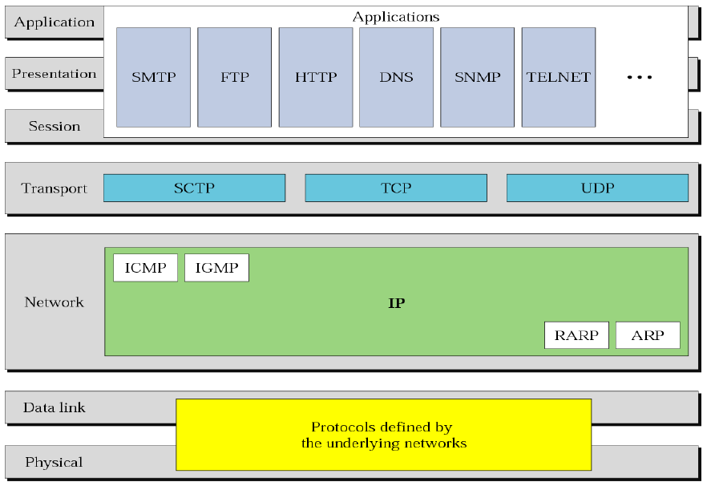
Raw Socket(cont.)
Position of ICMP in TCP/IP Protocol Suite

Slide 18
Raw Socket(cont.)
ICMP Message Format
  TYPE
    Type of ICMP message
      TYPE = 8: Echo request
      TYPE = 0: Echo reply
      TYPE = 13: Time stamp request
      TYPE = 14: Time stamp reply
  CODE
    Used by some types to indicate a specific condition
  CHECKSUM
    Checksum over full message
  Contents
    Depend on TYPE and CODE
IP datagram
IP Header
ICMP Message
20 bytes
Variable length
0
8
16
31
TYPE
CODE
CHECKSUM
Contents

Slide 19
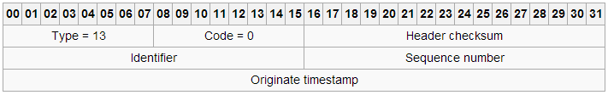
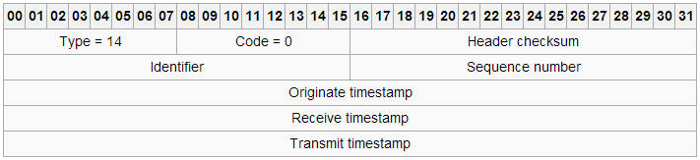
Raw Socket(cont.)
Timestamp Request and Reply
  Two goals
    Determine the round-trip time needed for an IP datagram
    Synchronize the clocks in two machines
  Timestamp request
  Timestamp reply

Slide 20
Outline
Socket API
Socket Example
Raw Socket
Homework Assignment #4

Slide 21
Homework Assignments #4
Basic:
  Write a program to simulate the ping application (command) and calculate the RTT value (70 pts)
Advanced: (30 pts)
  Write a program to simulate the traceroute application (command)

Slide 22



Homework Assignment #4 Basic: (70 pts)
In this work, you are asked to use timestamp request/reply message to simulate the ping application and calculate the RTT value
  Write a program that send a ICMP timestamp request packet to a host, and receive a ICMP timestamp reply packet
  Furthermore, calculate the Round-Trip-Time (RTT)
Calculate
Round-Trip-Time
ICMP timestamp request
ICMP timestamp reply

Slide 23
Flowchart
Header
#include <sys/types.h>
#include <sys/socket.h>
Define: int socket(int domain, int type, int protocol);
The third parameter, protocol, is ICMP
Ex: sd = socket(PF_INET, SOCK_RAW, 1);
Start
Establish
socket
Header:
#include <netinet/ip_icmp.h>
#include <netinet/ip.h>
EX:
struct icmp *icmp_hdr = (struct icmp *) send_buf;
//Define ICMP timestamp
icmp_hdr->icmp_type = 13;
icmp_hdr->icmp_code = 0;
icmp->icmp_otime = Use gettimeofday() function; (<sys/time.h>)
：
icmp_hdr->icmp_cksum=calculate icmp_hdr checksum;
Establish
ICMP
packet

Slide 24
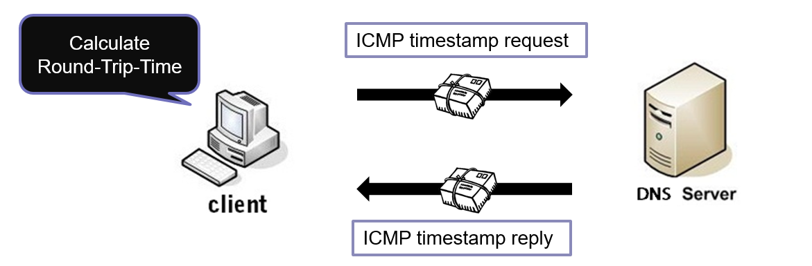
Flowchart (cont.)
Use sendto() function
Ex:
sendto(sd, send_buf, packsize, 0, (struct sockaddr*)&addr, sizeof(addr));
//packsize at least 12 byte ( ICMP Header 8 byte + Original timestamp 4 byte)
Send
ICMP
request
T1
T2
Use recvfrom() function
Ex:
recvfrom(sd, recv_buf, sizeof(recv_buf), 0, NULL, NULL);
T4
T3
Receive
ICMP
reply
struct icmp *icmp_hdr_recv = recv_buf + ip->ip_hl<<2; //Skip IP header
Original timestamp (T1)=>28 ~ 31 byte
Receive timestamp (T2)=>32 ~ 35 byte
Transmit timestamp (T3)=>36 ~ 39 byte
Final timestamp (T4)
Use gettimeofday() function for T4
RTT = (T4 – T3) + (T2 – T1)
Calculate
RTT

Slide 25
Note
Please use Linux platform
Define ICMP Original timestamp contents
  Not only define icmp_type and icmp_code
Be careful about packet size of sender and receiver
  Send ICMP packet
  Receive IP and ICMP packet
Make sure that all necessary header file be included
If you use virtual machine, you should set port forwarding that packets can find correct address to be received
You can test 140.120.1.2 or 140.120.1.21 or 140.120.13.1
  The DNS servers in NCHU

Slide 26
Executable Command
Format: ./myping [IP Address]
ex:
$ sudo ./myping 140.120.1.2
icmp_type = 13, icmp_code = 0
Original timestamp = 31095944
Receive timestamp = 0
Transmit timestamp = 0
Final timestamp = 0
-------------------------------------------
icmp_type = 14, icmp_code = 0
Original timestamp = 31095944
Receive timestamp = 4234532865
Transmit timestamp = 4234532865
Final timestamp = 31095957
RTT = 13

Slide 27



Homework Assignment #4: Advanced (30 pts)
    In this work, you are asked to simulate traceroute application to find the path (routers) between your machine and destination machine.
ICMP
TTL: 1
ICMP
TTL: 2
ICMP
TTL: 3
Report timeout
Report timeout
ICMP
TTL: 1
ICMP
TTL: 2
ICMP
TTL: 1

Slide 28
Homework Assignment #4: Advanced (cont.)
    Teaching assistant will use traceroute program to compare with your result.
TA’s result (in Ubuntu)
Your result
$: traceroute 140.120.1.2
$: ./yourProgram 140.120.1.2
1: Source ip
2: Router1 ip
3: Router2 ip
.
.
.
N: RouterN-1 ip
N+1: Destination ip
Your ip
1: Source ip
2: Router1 ip
3: Router2 ip
.
.
.
N: RouterN-1 ip
N+1: Destination ip
Your ip
compare
140.120.1.2
140.120.1.2
Hint : sock = socket(PF_INET, SOCK_RAW, IPPROTO_IP)

Slide 29
Turn in
Deadline
2019/6/19 23:59:59
Upload to i-learning
File name
  HW4_ID.zip (e.g. HW4_7105056035.zip)
    Source code
    Word file
If you want to update
  HW4_ID_New1.zip, HW4_ID_New2.zip….etc
If you don’t hand in your homework on time, your score will be deducted 10 points every day.

Slide 30
TA
Name: Yifen Wu(吳宜芬)
Email: emma62042@gmail.com
  Title format: TCP/IP HW# - [your name]
Lab: OSNET(1003A)

Slide 31

ANY QUESTION?

